Slide 1
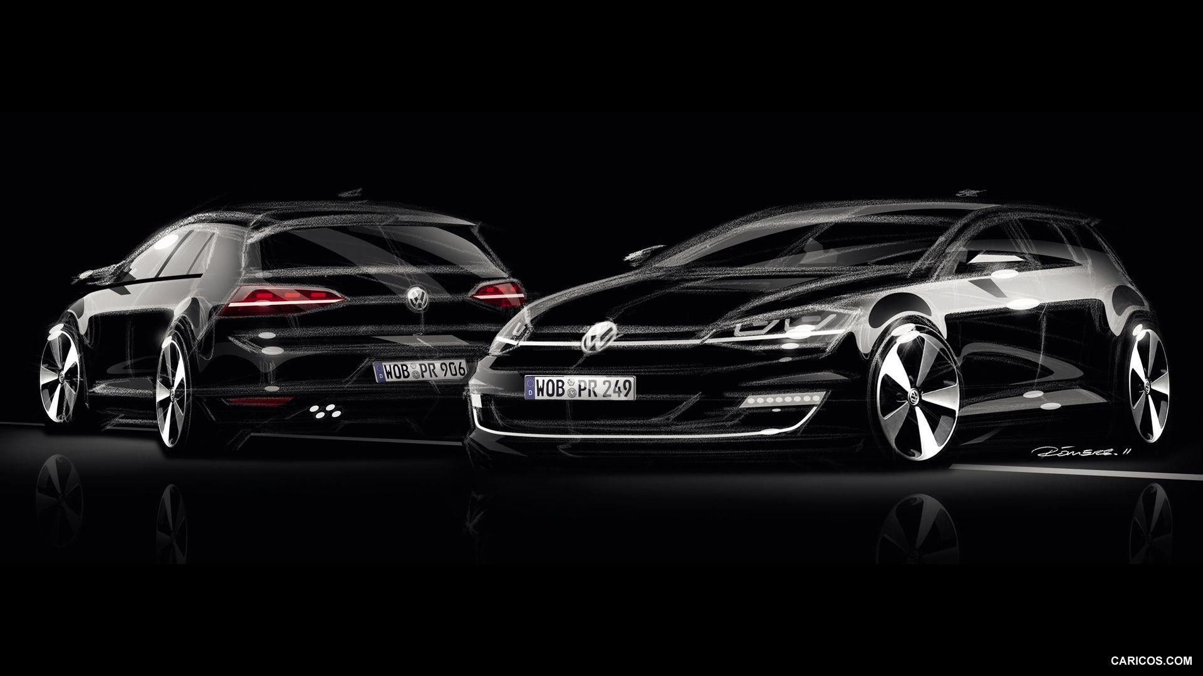




VOLKSWAGEN
An Enterprise Priority Process & IT Analysis
Ray Chang
Will Dannacher
Akshitha Shankar
Vahin Vuppalanchi

Slide 2

Agenda
Introduction
Recommendation
Implementation
Financials
Risks & Mitigations
Conclusion

Slide 3



Volkswagen holds a valuable position in the automobile industry
Volkswagen, known for innovation, is proactively diversifying its products to align with emerging trends like mid-sized SUVs and special-purpose vehicles. The NRG Program aims to drive unprecedented growth for VWoA. One key focus is establishing prioritized high-level business goals.
Previously,
Previously
To tackle rising IT costs and inefficiencies, VWoA set up the BPTO department with Matulovic leading alongside a PMO. Their efforts successfully realigned projects within budget and timelines. This led to a structured project prioritization process involving ELT, PMO, IT Steering Committee, and DBC. However, limited funding later raised doubts about its effectiveness.
However,
Begging the question,
To what extent is the new project selection process deemed effective and indispensable? What strategic rationale underlies the allocation of $16 million in IT-controlled expenditure at Volkswagen?
Notes:
BPTO: Business Process Technology and Organization
PMO: Program Management Office
Executive Leadership Team ELT
Digital Business Council
Next Round of Growth

Slide 4
Our recommendation will improve the prioritization process and rationalize the $16M IT-controlled spend
Include Multi-Phased Projects As An Additional Factor to Consider During Prioritization
Allocate IT Budget into Distinct Categories to Emphasize for Investment Purposes
Divide large, high budget projects are divided into multiple phases
Prioritize completion and overall success of fragmented projects during the prioritization process
Improve underfunded IT department to ensure uninterrupted business operations
Direct investments towards scalable technology solutions to meet growing business demands
GOAL: Prevent issues like the SAP project left partially funded from happening again in the future
GOAL: Ensure that Volkswagen's large IT investment provides solutions for long-term business growth

Slide 5
The prioritization process enables transparency in decision-making, and fosters a unified focus on achieving shared corporate goals
ENSURES TRANSPARENCY
DRIVES BUSINESS ALIGNMENT
ENCOURAGES OWNERSHIP
Prioritizing projects based on enterprise goals ensures that funding is directed towards initiatives that align with the company's overarching strategic objectives.
Enables stakeholders to understand why certain projects were funded while others were not.
This transparency builds trust and helps prevent misunderstandings or perceptions of favoritism.
The shared responsibility of all stakeholders to take ownership of the outcomes ensures that decisions are made collectively, reducing the likelihood of individual units feeling marginalized or overlooked.
Notes:
By involving all business units in the prioritization process, IT is seen as a facilitator rather than an obstacle. This helps overcome potential resistance or skepticism towards IT initiatives.
The process encourages all stakeholders to take ownership of the outcomes. This shared responsibility ensures that decisions are made collectively, reducing the likelihood of individual units feeling marginalized or overlooked.
- encourage business units to propose more projects that fall under high-priority enterprise goals
- make it clear that pushing towards enterprise goals is the clear way to go
- enterprise-level success would increase the overall position of the company, thus directly impacting every business unit in a positive way
- Ensures transparency in the selection process
- Links projects directly with the core processes and enterprise goals
- Fosters collaboration

Slide 6
Aligning IT investments with business goal prioritization positions IT as a facilitator that directly contributes to overall success, rather than an obstacle.
Agility:
The selection process allows IT to adapt quickly to changing business priorities. If new strategic objectives emerge, IT can adjust project portfolios to ensure alignment with evolving goals.
Customer-Centricity:
As the top-ranking enterprise goal is customer loyalty, the evolving project selection process will focus on enhancing the customer experience. IT will prioritize projects that improve customer-facing systems and services to meet changing expectations.
Mitigation of IT Obstacles:
Addressing historical perceptions that IT is an obstacle to business objectives allows IT to rebuild trust and credibility within the organization. It positions IT as a valuable partner in achieving strategic goals
Notes:
Volkswagen, renowned for its history of innovation, is currently facing a downturn. To address this, VW executives have taken a proactive approach by diversifying their product line to align with emerging trends. This includes focusing on midsized vehicles, Sports Utility, and special-purpose vehicles.
From 1992 to 2002, Volkswagen of America (VWoA) prioritized marketing and sales, reducing internal IT staff after outsourcing to Perot Systems. In 1999, gedasUSA was established to oversee IT operations. The late 1990s saw the emergence of eBusiness teams for digital marketing. By 2002, concerns arose about rising IT expenses and inefficiencies. To address this, VWoA established the Business Process, Technology, and Organization (BPTO) department led by Matulovic. The PMO was empowered to manage projects, ensuring planning and budget adherence. By 2002, projects were consistently on schedule and on budget, prompting a focus on project selection.
Volkswagen of America (VWoA) implemented a structured process to manage project priorities. The Executive Leadership Team (ELT) oversaw the NRG program, including new IT governance. An IT steering committee and the PMO subsection of BPTO were established to guide project selection and administration. The Digital Business Council (DBC) assessed projects' impact and alignment with goals. Three phases spanned three months: Calling for Projects, Formal Project Requests, and Transforming Business Unit Requests. However, when faced with limited funding, tensions arose over project prioritization, challenging the efficacy of the new process. The question remains: how to balance business unit needs with enterprise goals within budget constraints? By addressing these critical areas, we aim to transform the IT function into a strategic enabler that aligns seamlessly with Volkswagen of America's business objectives. This investment in IT capabilities will not only support the NRG program but also position us for sustained growth and success in the dynamic automotive industry.

Slide 7



A significant portion of the IT spend should be allocated towards three focus areas
Sourcing –
Vendor Management
Operating Mode -
IT-Business Relationship
People -
Talent Management
1
Leads to cost savings through negotiation, volume discounts, and efficient procurement procedures.
1
Improves communication and collaboration between IT professionals and employees in other departments
1
Improves VW's ability to retain talent by giving employees opportunities for growth and constant learning
2
Produces vendor reports for quality assurance
2
Ensures alignment with business objectives to drive overall business success
2
Establish VW as a top employer, enhancing their ability to attract top talent
3
Provides scalability for vendor relationships and management processes
3
Allows for quick IT response times to other business units
3
Strengthen VW's employees to develop skills by investing in workshops and training programs

Slide 8
VW will be able to reform both of their processes with linear flows
Modified Prioritization Process
Utilize IT Spend with a Cyclical Plan
Review Projects List from Business Units
Assess and Identify Requirements
Identify Projects With Dependencies And Incomplete Projects
Determine Alignment to Enterprise Vision
Invest in Necessary Tools
Ensure That Unfinished Phases of Projects Get More Priority Than Other Projects
Determine Success via Metrics
Re-adjust The Priorities Associated

Slide 9
Allocating the IT spend towards three categories will yield the best results
Category | Spending
Sourcing – Vendor Management | $3.5 Million
Operating Mode – IT-Business Relationship Management & Service Delivery | $7.0 Million
People – Talent Management | $3.5 Million
Leaves Two Million Allocated Towards Maturity Challenges, Organizational Change Management, and Post-Portfolio-Selection Implementation Activities
Category | Cost Breakdown
Sourcing | Vendor Management Software | $1.5M | Training & Education for Supplier Relationship Management | $1.5M | Supplier Performance Incentives | $1M
Operating Mode | Regulatory Compliance | $2M | Data Security & Recovery | $2M | Business Continuity | $3M
People | Recruitment and Acquisition Tools | $1M | Development and Training Programs | $1.5M | Employee Benefits and Wellness | $1M

Slide 10
Investments this large always come with risk
Risk
Severity
Mitigation
Misconception of the process
Business units do not fully grasp the benefits of the innovative process
Provide education behind the process to ensure all stakeholders understand the purpose, methodology and expected outcomes
Impact
Likelihood
Resistance from business units
Highly likely as BU’s historically resist change
Resistance due to possible learning curve
Transparent and effective communication
Demonstrate the value behind funding projects that align with high-ranked enterprise goals
Impact
Likelihood
Exceed IT budget
Involves one or more projects’ costs exceeding the budget
Typically happens when there is low governance or adherence to policy
Have clear restrictions regarding budgets devoted to each project
Implement a no-tolerance policy for exceeding budget
Impact
Likelihood
Notes:
There is a risk that critical projects, like the supply flow project, may not receive adequate funding due to the prioritization process, potentially impacting overall strategic objectives of the business
Maintain flexibility in the process to allow for adjustments based on emerging needs and unforeseen circumstances.

Slide 11
In conclusion, VW will enhance its future with this new prioritization process and proper IT spend
Innovative Prioritization Process:
Separating large expensive projects into multiple phases while prioritizing the fragmented projects will prevent partially funded events and ensure VW’s future transparency and success.
IT-Spend:
Allocating sufficient IT spend towards sourcing, operating mode, and people will drive VW into the future of business transformation.
Following all steps of our recommendation will lead to Volkswagen’s commercial success as an automotive leader and opportunities for growth for many years to come. Together, we can position Volkswagen for long-term success and expand its opportunities in the market.

Slide 12
Appendix
Existing Priority Process
Existing Approval Process
Budget Allocation Additional Areas
Benefits Delivery Network
VW SWOT Analysis
Additional Risks
Prioritization Process
Budget Allocation

Slide 13
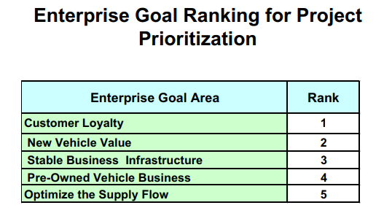

Project Prioritization Ranking (Existing)

Slide 14
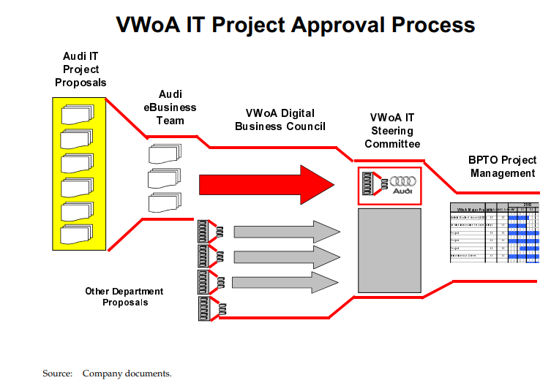
Project Approval Process (Existing)

Slide 15


Minor Areas of IT Budget Allocation
Architecture –
Maturity and Readiness Challenge
Governance-
Post-Portfolio-Selection Implementation Activities
Culture-
Organizational Change Management
1
Produces an overall superior implementation with better planning, infrastructure, and value chain
1
Develop VW’s ability to collaborate and produce a primary vision for implementation
1
Improves VW's ability to manage the effect of new technology and changes in organizational structure
2
Enhance VW’s ability to assess their processes, products, and organization in addition to understanding their maturity level
2
Leads to a clear process of planning and executing the necessary steps for digital transformation
2
Establish VW as an innovative employer by transforming their organization

Slide 16
Benefits Delivery Network Diagram for the Prioritization Process (with modifications)
Holistic approach to decision-making
Implement the new prioritization process for IT Projects in VWoA
Comprehensive view of projects ranked as per the priority of enterprise goals
Enhanced Transparency
Highlighting dependencies between projects
Structured approach to budget allocation
Alignment of IT projects to strategic goals
Update the process to consider multi-phased projects at a higher priority
Maximized Business Value
Categorize initiatives and group them into common enterprise projects
Efficiency in Resource Allocation
Involvement of business stakeholders and IT
IT Enablers
Enabling Changes
Business Changes
Benefits
Investment Objectives
16

Slide 17
VW SWOT Analysis
STRENGTHS Diversify and strengthen supplier relations Reduce dependency on limited suppliers Increase efficiency by using automation | WEAKNESSES High initial cost of investment Some ongoing maintenance costs are required Uncertainty of ROI
THREATS Higher dependency on IT data management can lead to security attacks High training needs are required for a department to be fully qualified | OPPORTUNITIES Allows for much easier scalability with a stronger IT base Allows for better global reach Increases ability for solid and informed decision making
17

Slide 18
Additional Risks
Risk
Severity
Mitigation
Keep scalability in mind when determining equipment early
Roll out technological upgrades in waves to avoid massive overhauls
Technology doesn’t scale effectively
Impact
Likelihood
Approach integration from a top-down approach realizing the specific interactions from BU to BU
Develop an integration model early on
Integration Challenges
Impact
Likelihood
Have a clear timeline regarding certain activity scope and duration
Determine the feasibility of certain tasks and projects during the planning phase
Scope Creep
Impact
Likelihood

Slide 19
The Prioritization Process enables transparency in decision-making, and fosters a unified focus on achieving shared corporate goals
Alignment with Corporate Strategy:
The current project selection process aligned the business unit’s projects with the enterprise’s level strategic goals and objectives. The selection process ensures that the selected projects help achieve the enterprise’s business goal in the best way, and investments directly contribute to achieving these goals.
Greater Transparency:
Explain that the process promotes transparency in decision-making. It involves various stakeholders, including ELT members, business units, and the Digital Business Council (DBC), in the project selection process. This transparency fosters trust and collaboration.
Ensure Ownership:
The process encourages all stakeholders, such as the Executive Leadership Team and business units, to take ownership of the outcomes. This shared responsibility ensures that decisions are made collectively, reducing the likelihood of individual units feeling marginalized or overlooked.
Notes:
By involving all business units in the prioritization process, IT is seen as a facilitator rather than an obstacle. This helps overcome potential resistance or skepticism towards IT initiatives.
The process encourages all stakeholders to take ownership of the outcomes. This shared responsibility ensures that decisions are made collectively, reducing the likelihood of individual units feeling marginalized or overlooked.
- encourage business units to propose more projects that fall under high-priority enterprise goals
- make it clear that pushing towards enterprise goals is the clear way to go
- enterprise-level success would increase the overall position of the company, thus directly impacting every business unit in a positive way
- Ensures transparency in the selection process
- Links projects directly with the core processes and enterprise goals
- Fosters collaboration

Slide 20
Detailed budget allocation
Sourcing
License and Subscription Renewals
Allocate budget for renewals of operating system licenses, productivity software, and cloud service subscriptions.
Outcome:
Ensuring that daily operations are not disrupted due to IT failures is critical.
Allocate resources for vendor management personnel and tools.
Outcome: Ensure cost control and service quality
Operating Mode
Business Continuity:
Allocate budget to routine maintenance tasks, such as server updates, software patching, hardware diagnostics, and equipment cleaning.
Outcome: Ensuring that daily operations are not disrupted due to IT failures is critical. can prevent costly downtime and emergency repairs.
Data Security:
Allocating the budget into Investing in firewalls, intrusion detection systems, antivirus software, employee training, and regular security audits
Outcome: safeguarding sensitive data from breaches and cyberattacks to protect the organization and its customers.
Regulatory Compliance:
Allocate funds for compliance assessments, data protection tools, and legal consultations.
Outcome: Investing in "run" activities ensures compliance with these regulations, avoiding legal consequences.
Data Backup and Recovery
Allocate budget for backup software, storage infrastructure, cloud storage subscriptions, and disaster recovery planning.
Outcome: protecting against data loss due to system failures, cyberattacks, or human errors
People
Training and Skills Development:
Allocate resources for training programs, certifications, and workshops.
Outcome:
Continuous training and skills development for IT staff ensure they stay updated with the latest technologies and best practices.

